Slide 1
#HeyBlue
Full project Overview

Slide 2
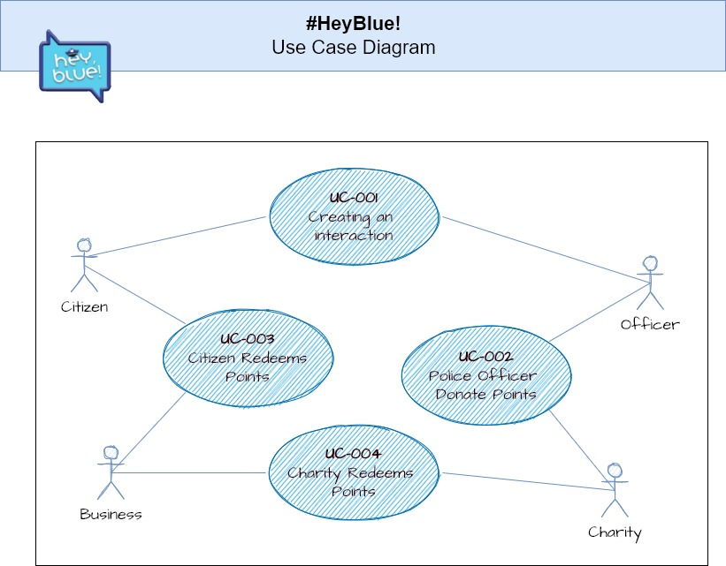
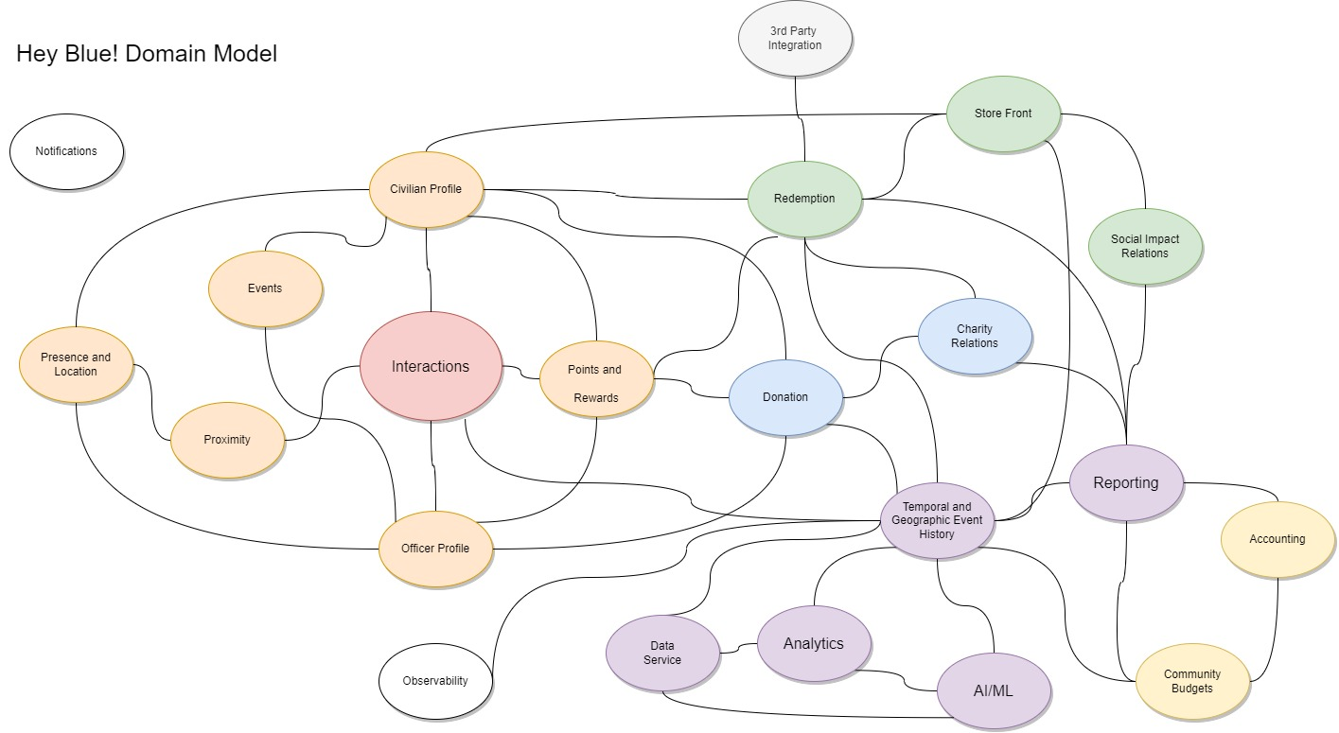
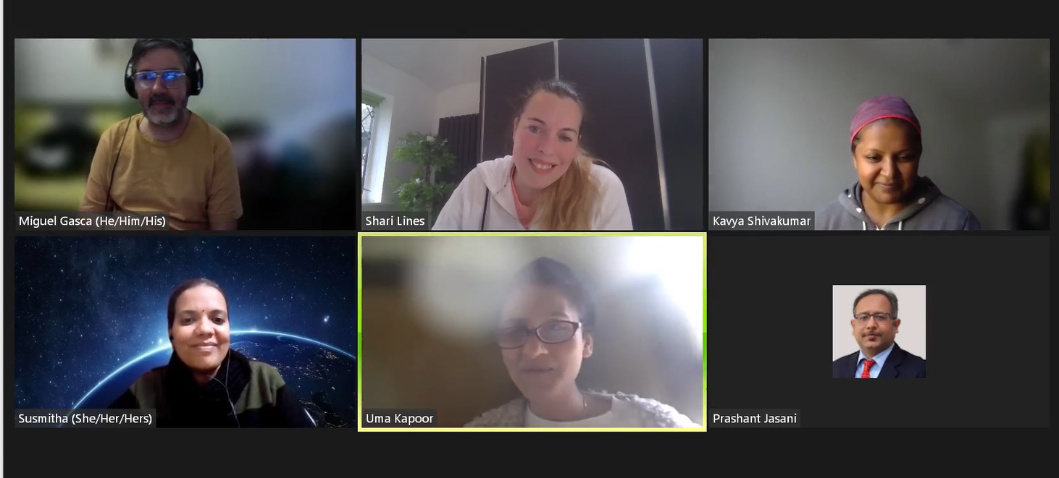
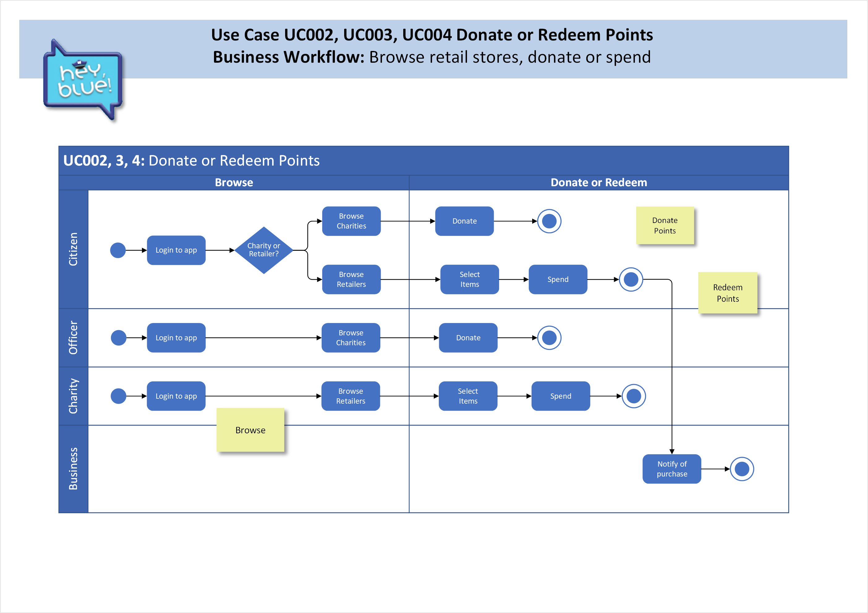
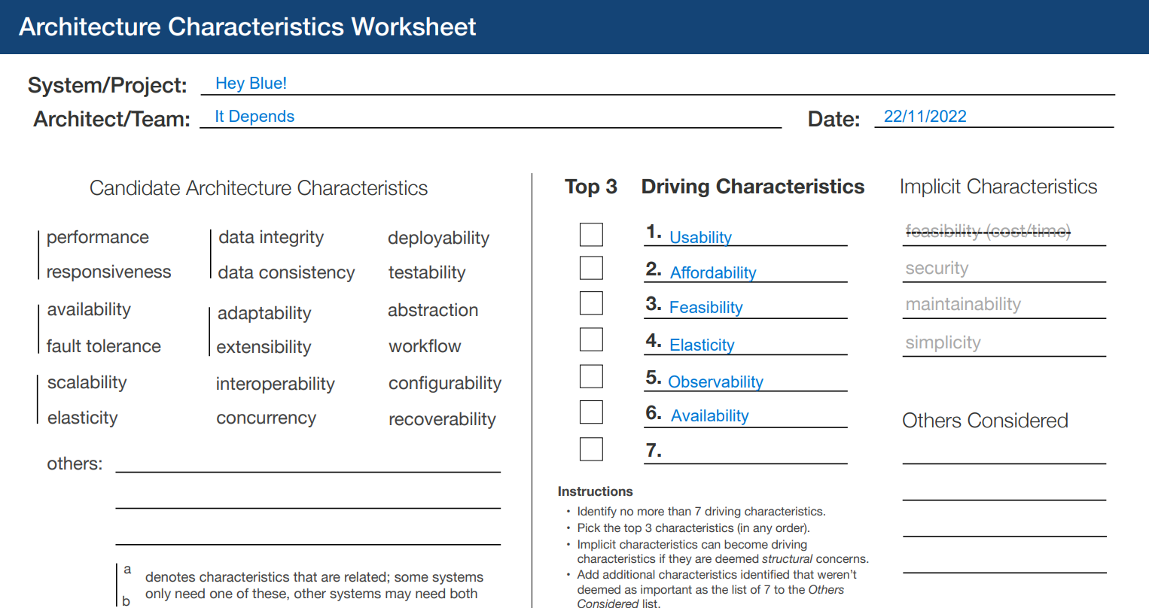
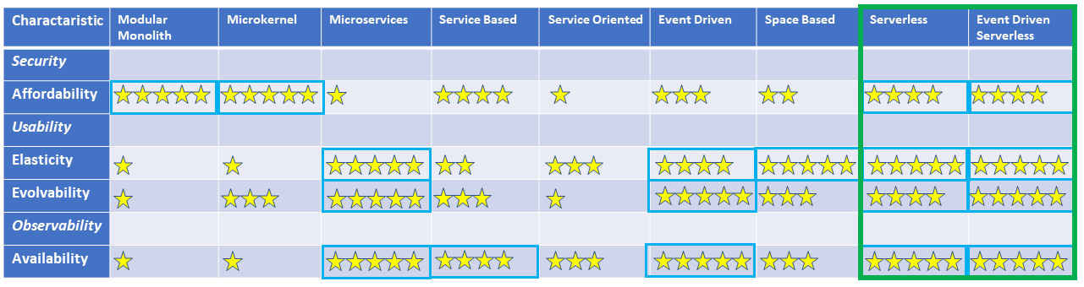
Skills, specialties
Working patterns
Commitment

Slide 3
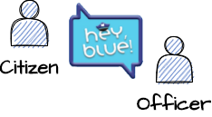
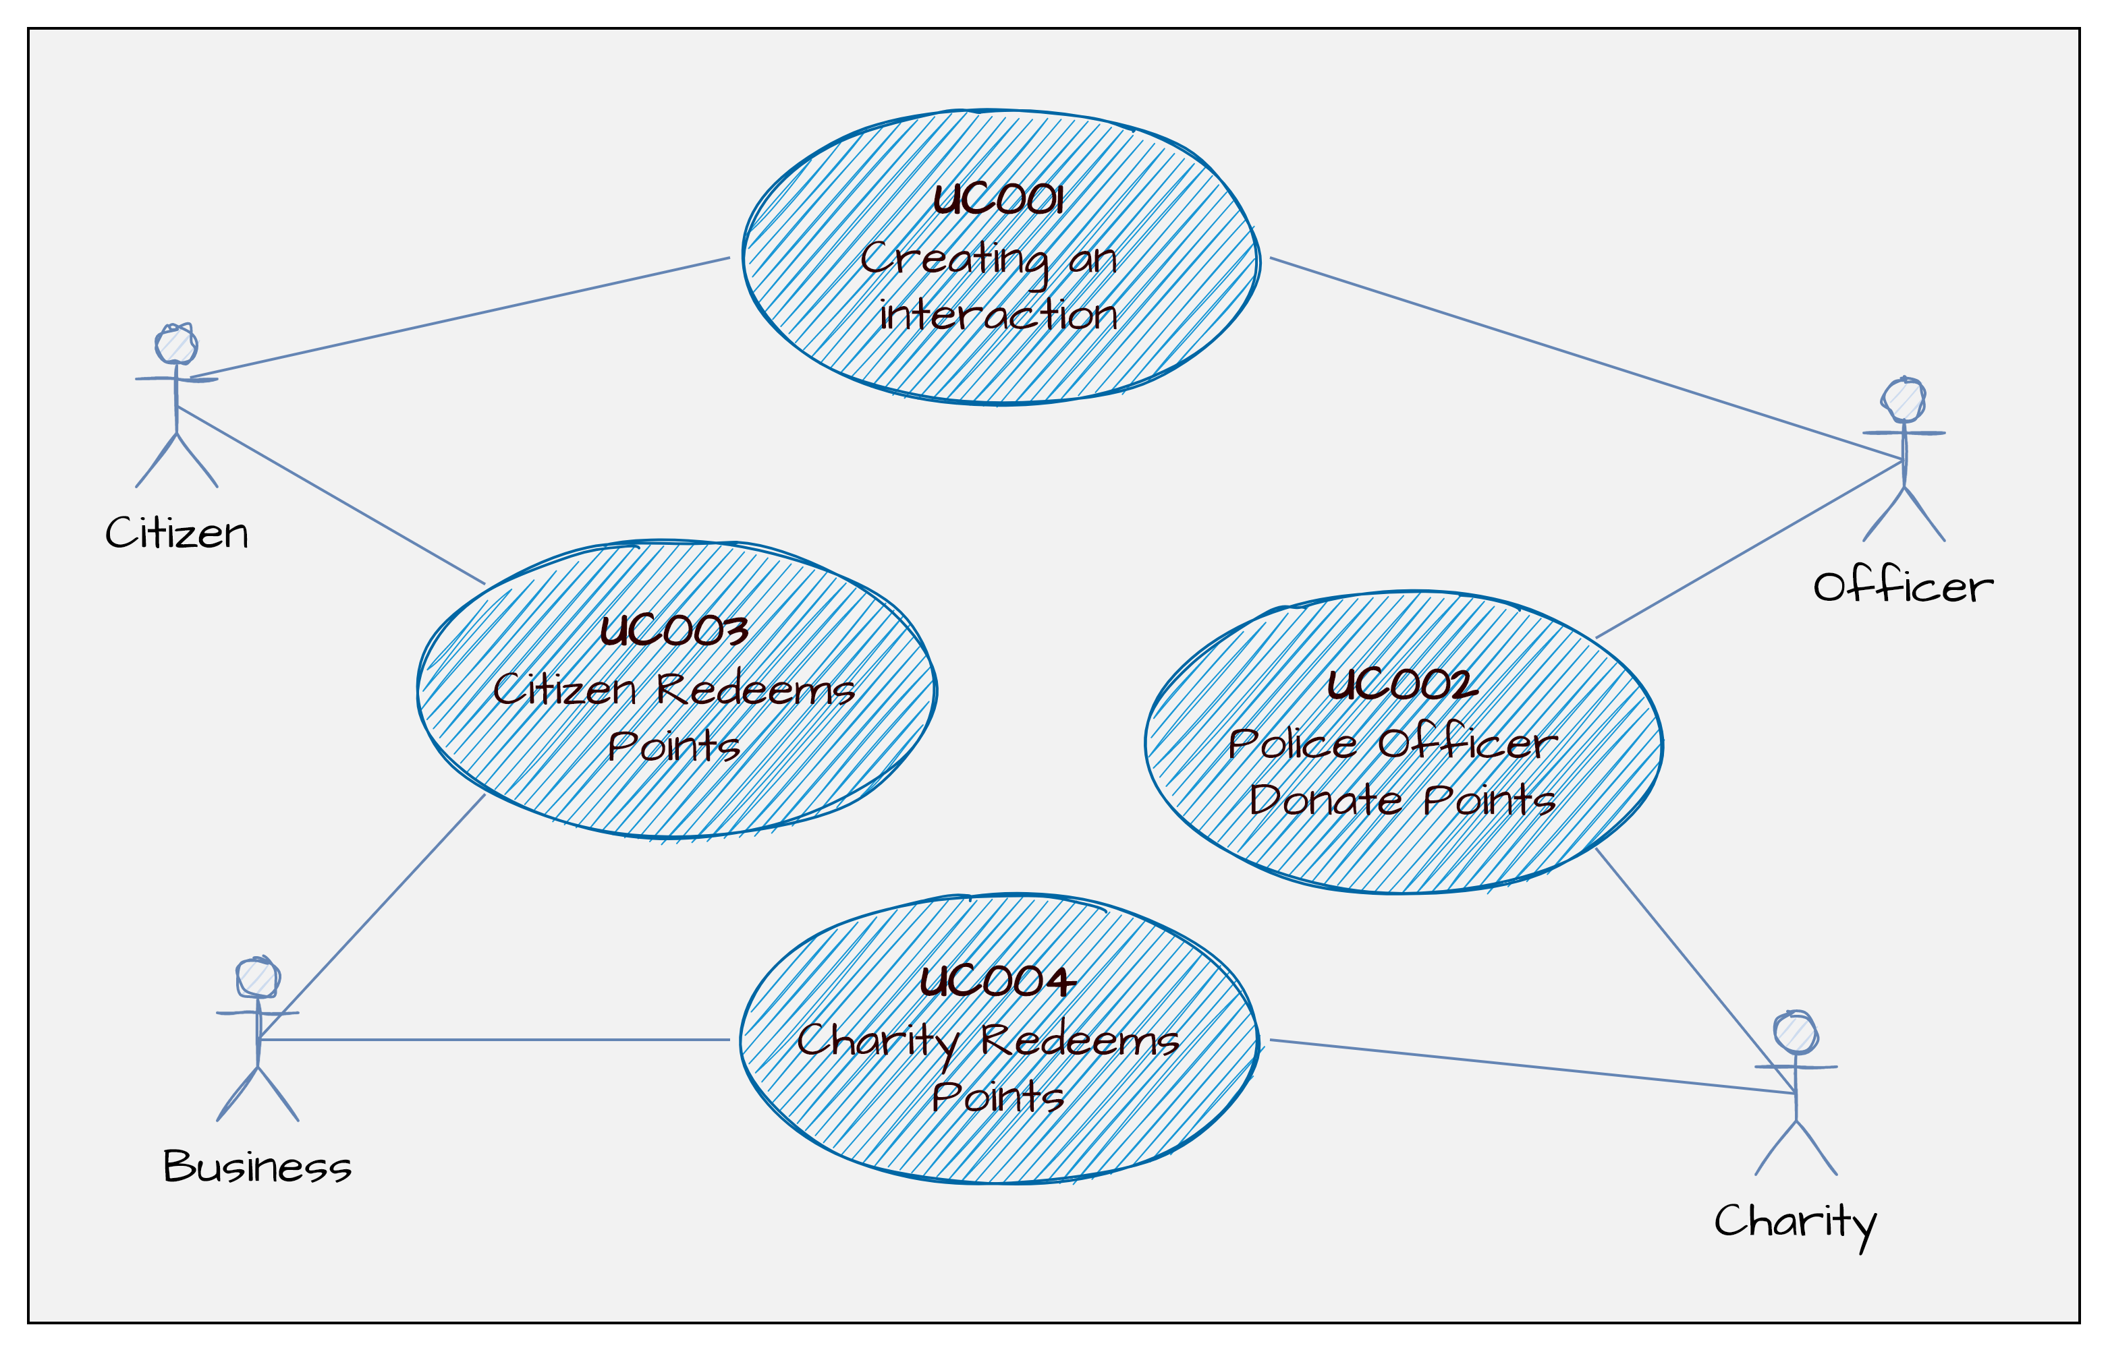

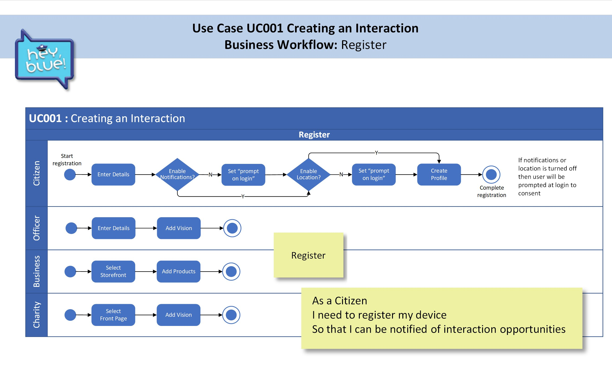
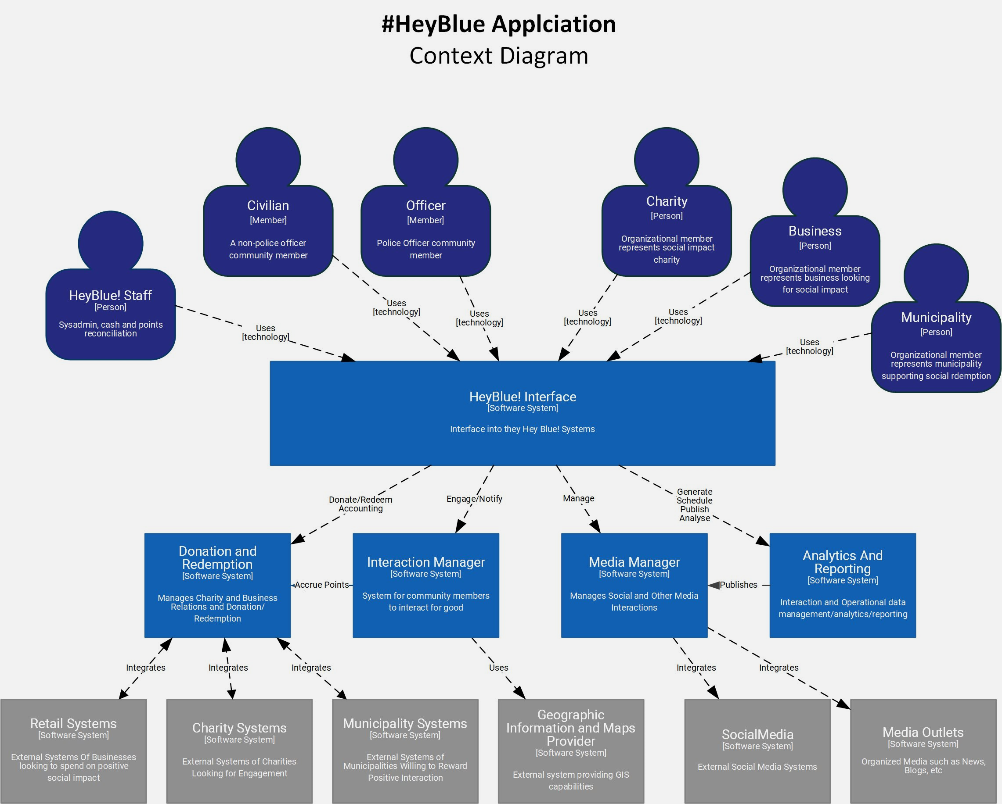

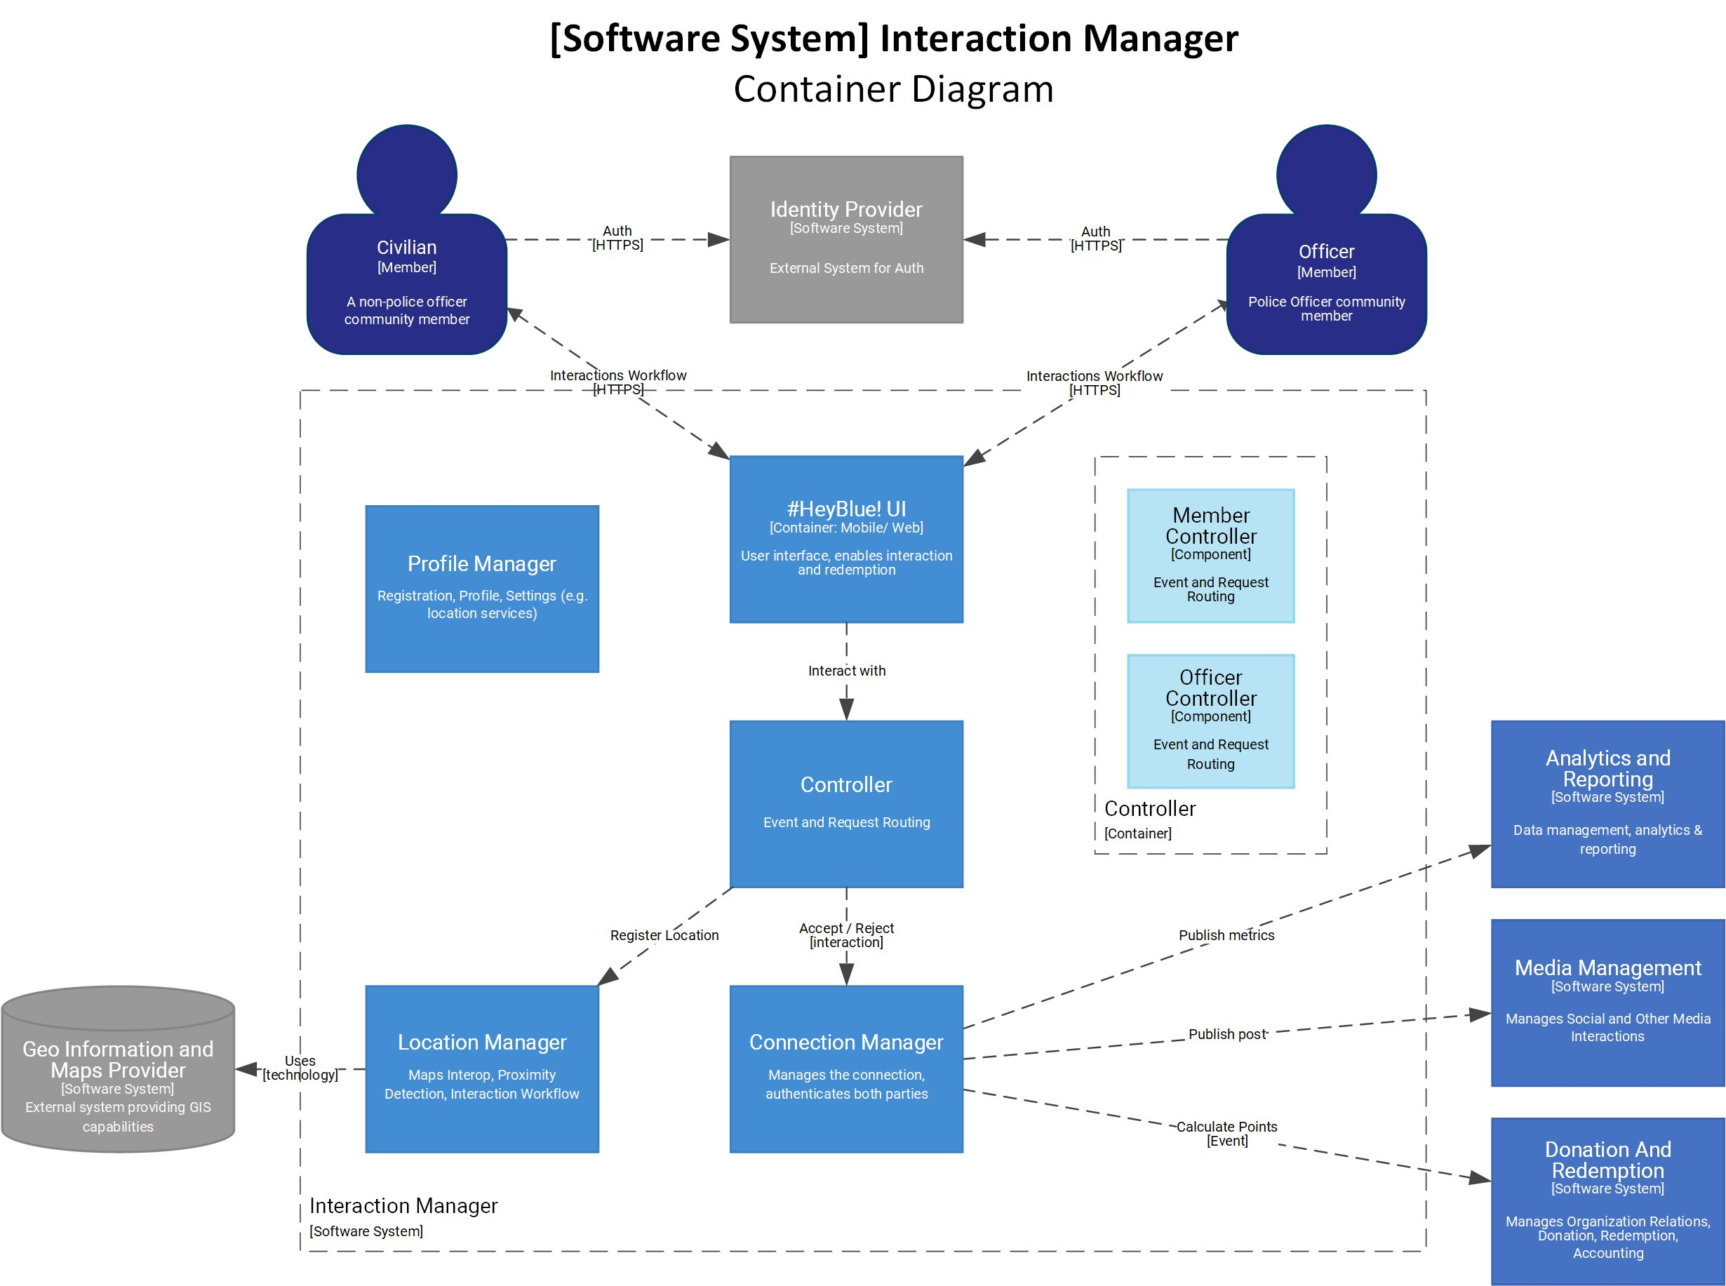
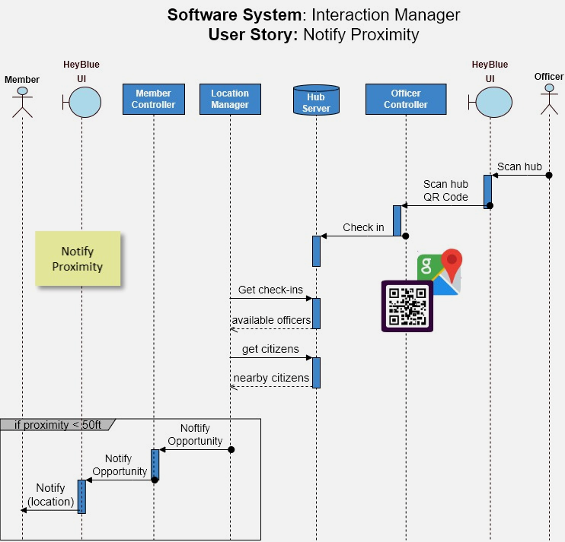
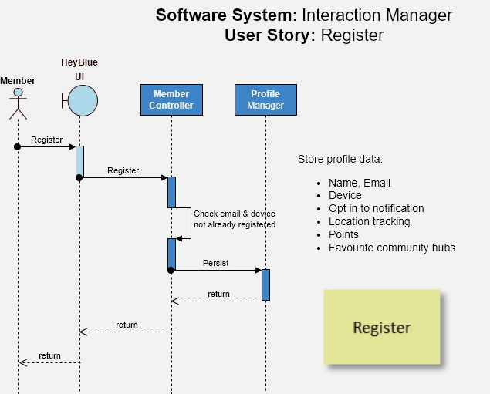
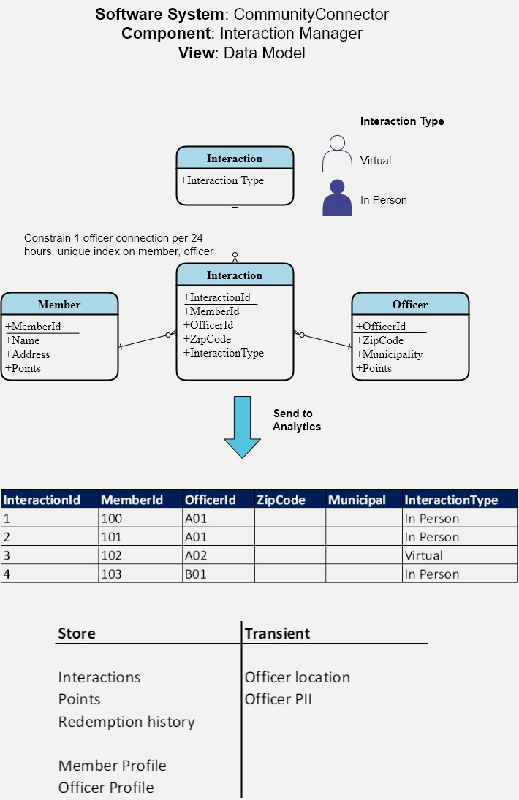
Connect the dots
SR-IM-007 Community members find the officers that are willing to connect
US-002 user story
ADR-005 on Security
ADR-013 on System Design
Straight
through
architecture

Slide 4
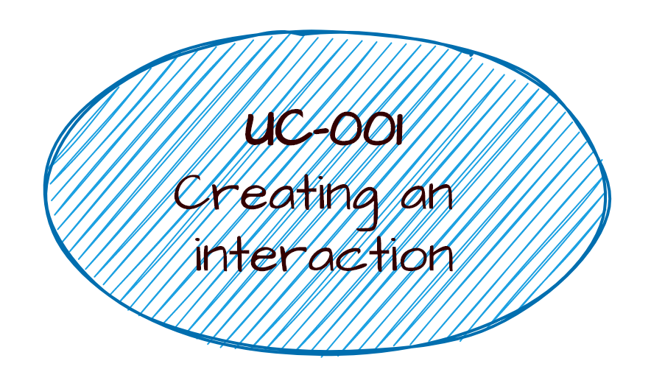
ADR-003 Architecture Characteristic Security
officer safety
zero trust
SR-01
Location tracking
SR-01
Single device
to email
US-001
Register
User
SR-02
Opt in notifications
US-002
Notify
Proximity
ADR-013 Design to protect officer location
Business storefront
IM-001 context diagram
IM-001 container diagram
IM-004 – sequence diagram
ADR-016 Data Protection, delete functionality

Slide 5
#HeyBlue! Requirements User Story Map
Interaction
Media
Donate & Redeem
Analytics & Reporting
US-001
Register
User
US-002
Notify
Proximity
US-003
Interact
US-004 Earn Points
US-005
Share
US-006
Register
3rd Party
US-007
Browse store
US-008
Redeem Points
US-009
Browse Charities
US-010
Donate
Points
US-011
Send to analytics
Create profile for Citizen
Location Tracking
Proximity Alert
Calculate Rewards
Share to #HeyBlue feed
Business storefront
Retailer creates storefront
Spend Manager
Charity Registers
Send to charity
Store metrics
Create profile for Officer
Officer location shutoff
Option to connect
Add rewards to profile
Share to Social Media
Charity front page
Store location alerts
Update points
Present metrics
Update profile
Get Map
Manage catalog
Purchase Items
Delete profile
Legend
Activity Group
User Stories
Task
Must have

Slide 6
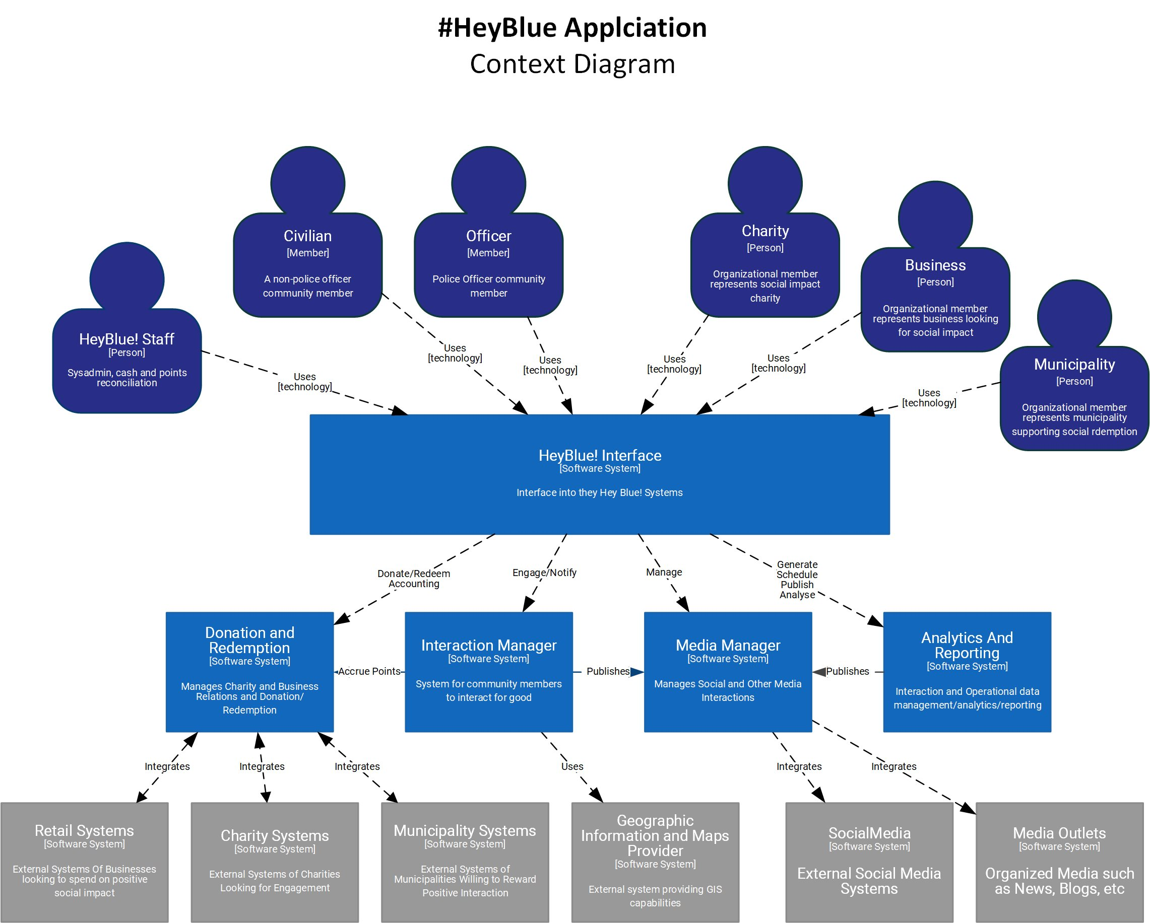
#HeyBlue! Solution
Context Diagram

Slide 7
#HeyBlue! Solution → Interaction Manager Software System Container Diagram

Slide 8
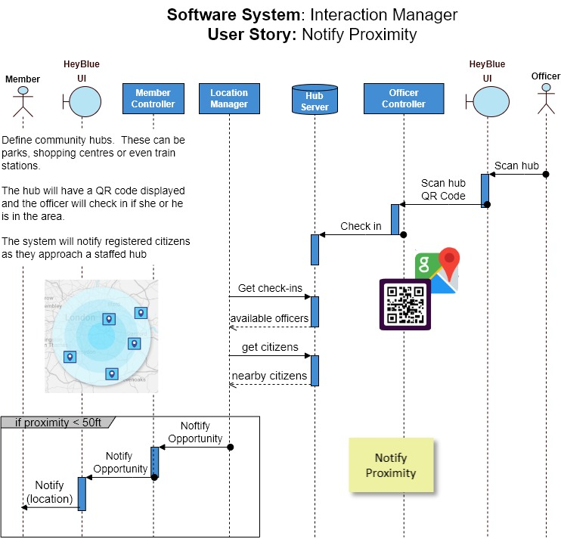
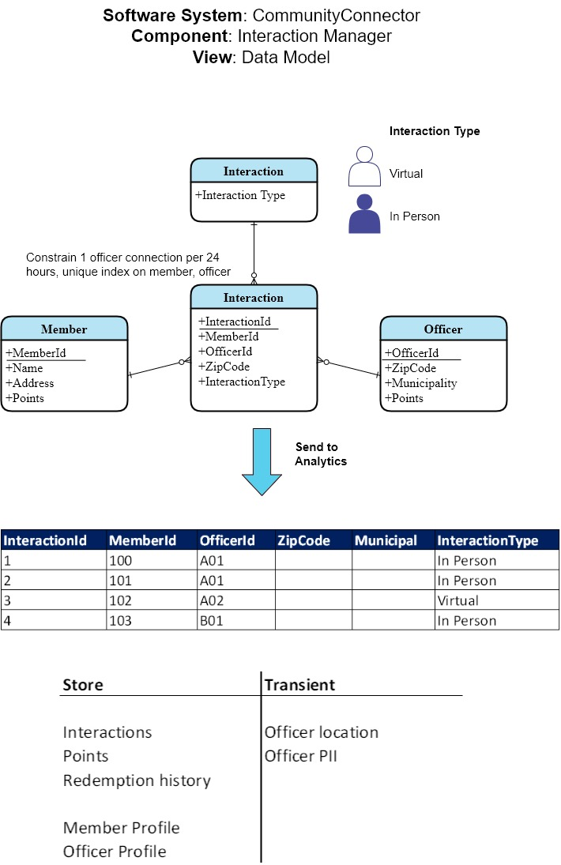
#HeyBlue! Solution → Interaction Manager Detailed Design and
Architecture Decision Record(s)

Slide 9
Lessons learned
Listen
Global

